Slide 1

OLIST STORE(E-COMMERCE)
OLISTSTORE E-COMMERCE ANALYSIS

Slide 2
CONTENT
Data Overview
KPI’S
Dashboard
Insights
Recommendations

Slide 3
Data Overview
The goal of the Olist Store Analysis project is to examine how customers interact with and make purchases on the Olist E-commerce platform. It focuses on crucial metrics like the difference in sales between weekdays and weekends, insights into payment trends, understanding delivery times, and exploring customer behavior. This analysis relies on nine CSV files, which undergo cleaning and manipulation processes to derive meaningful insights.

Slide 4
KPI’S
Weekdays Vs weekend payment statistics
Payment Type with review score 5
Average numbers of delivery days taken for pet shop
Average price and payment value of sao paulo city
Average shipping days vs review scores

Slide 5
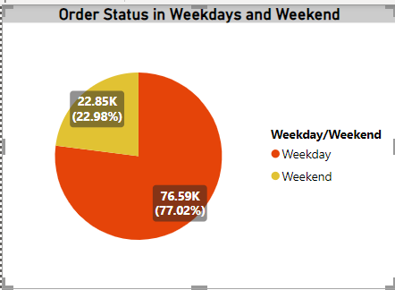
KPI-1 Weekday Vs Weekend Payment Statistics
It was observed that the count of order_status for weekend amounted to 76,594, which was notably higher compared to the count to the count of 22,847 for weekends. Specifically, Weekdays accounted for approximately 77.02% of the total count of order_status. This indicates that a significant majority of orders occur on Weekdays, suggesting that Olist experiences higher transactional activity during the weekdays compared to the weekends.

Slide 6
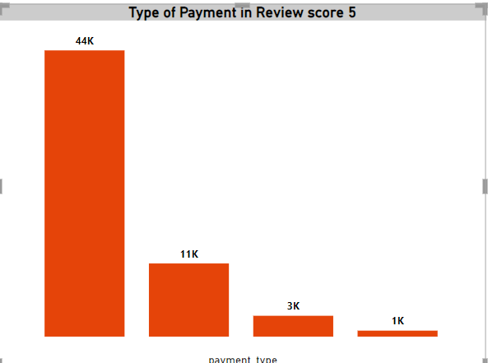
KPI-2 Payment Type with review score 5
Credit card payment contributed to approximately 44k of the total count of order_id associated with review score 5. This suggests a positive association between payment method and customer satisfaction, implying that cuatomers who choose a credit card payments are more likely to provide higher review score for their purchase.

Slide 7
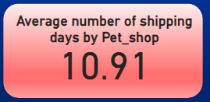
KPI-3 Average numbers of delivery days taken for pet shop
The average number of shipping days taken 10.19 days by pet_shop to reach their destination. This suggests that pet_shop generally maintains relatively efficient shipping process, ensuring that orders are delivered to customers within a reasonable timeframe.

Slide 8
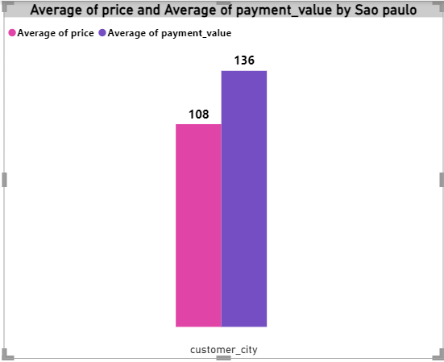
KPI-4 Average price and payment value of sao paulo city
Average price and Average payment_value are negatively correlated with each-other.
Average payment value and Average price diverged the most when the customer city was sao paulo, when Average payment value were 136 higher than Average price.

Slide 9
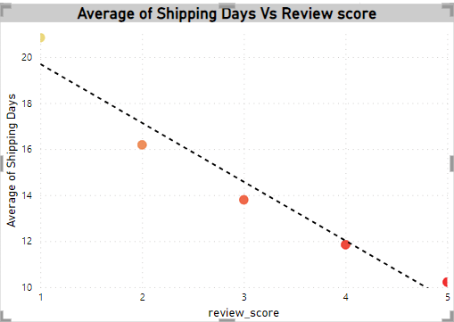
KPI-5 Average shipping days vs review scores
There is a Potential correlation between shipping days and Review score, when it had lower review score takes longer shipping days to reach the customers. It leading to dissatisfaction reflected in the review score.

Slide 10
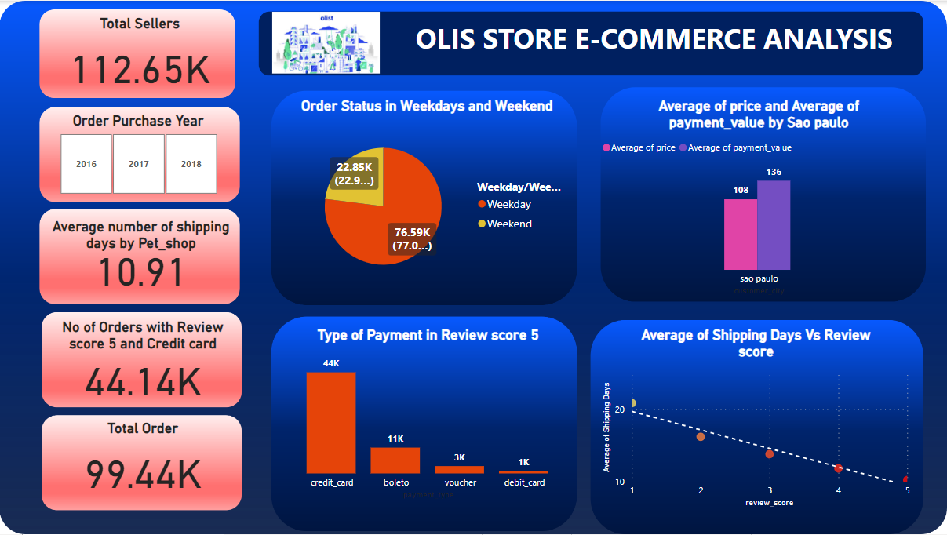

Slide 11
Insights
Olist E-commerce has a 90% delivery success rate, indicating room for improvement in delivery performance.
Their average product rating is 4.09 stars, with variant across product categories, suggesting potential quality issues in certain categories.
1-star reviews rank third in the distribution, hinting at possible product quality issues.
Insights can helps in focusing on popular products, improving product quality and service, and optimizing marketing efforts, especially in high-sales provinces.
Analysis provides an overview of customer consumption trends and patterns, guiding further business strategies.

Slide 12
Recommendations
Regularly analyze reviews to understand product quality and areas of improvement, utilizing dashboards for a data-driven approach.
Analyze undelivered orders and delays, considering geographic challenges for route optimization, and use telematics to track fleet performance.
Offer a robust tracking system for clear communication among customers, sellers, and couriers, providing regular updates and accommodating specific delivery instructions.
Foster trust and communication between all parties involved in the delivery process, facilitating collaboration to resolve any issues efficiently.

Slide 13
THANK YOU

